Slide 1
Chapter One: Overview
Wuman Luo, Amy
luowuman@ipm.edu.mo Office: A323 14:30-17:30 Tuesday & Thursday

Slide 2
Outline
A. Business Intelligence
Operational databases vs. data warehouses
Defining features of data warehouses
B. Architecture
Two layers. "why don't run analysis on operational data?"
Data warehouse vs. data mart
Hub-and-spoke vs. Bus
Reconciled data layer
C. Design Methodology
ETL process
Seven phases in data mart design
Data mart design in future chapters

Slide 3
Part A. Business Intelligence
Operational systems and databases
Decision-support systems
Different data requirements
Business Intelligence
Data warehousing vs. Data analysis
Features of Data warehouse
Operational databases vs. Data Warehouses

Slide 4
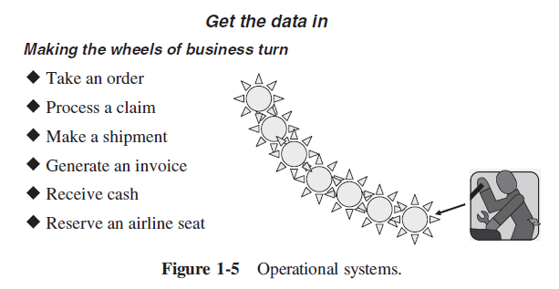
Operational Systems and Databases
Operational systems "make the wheel of business turn"
E.g. Point-of-sales, inventory control, online banking
Also known as OLTP (Online Transactional Processing)
.. supported by numerous operational databases.
Read/Write access. Update frequently
Integrity is important
Avoid data redundancy
Normalized data model
Pre-determined transactions in application programs.
Keep current data only
...
Notes:
These operational systems such as order processing, inventory control, claims processing, outpatient billing, and so on are not designed or intended to provide strategic information.
A POS system allows your business to accept payments from customers and keep track of sales.

Slide 5
Data ≠ Information
Operational systems generate a huge amount of detail data
The managers need strategic information to make proper decisions. Usually, huge amount of data is summarized with tailor-made queries and presented in reports for managers.
Availability of too much data makes the extraction of the most important information difficult
Value
Strategic knowledge
Reports
Selected information
Operational data
Quantity

Slide 6
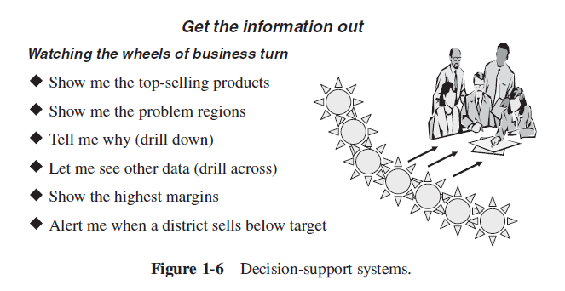
Decision-Support Systems
Decision-support systems helps managers to make proper decisions when they establish objectives and monitor results
"Increase sales by 15% in the North East division over the next 5 years"
"Improve product quality levels in the top five product groups"
Decision-support systems "watch the wheels of business turn"
A common function is OLAP (Online Analytic Processing)
Notes:
On the other hand, specially designed and built decision-support systems are not meant to run the core business processes. They are used to watch how the business runs, and then make strategic decisions to improve the business
Decision-support systems are developed to get strategic information out of the database, as opposed to OLTP systems that are designed to put the data into the database. Decision support systems are developed to provide strategic information.

Slide 7
Example Queries to Decision-Support Systems
Q1: Find the 5 top-selling products for each product subcategory that contributes more than 20% of the sales within its product category.
Q2: As of Dec 15, 2020, determine shipping priority and potential gross revenue of the orders that have the 10 largest gross revenues among the orders that had not yet been shipped. Consider orders from the book market segment only.
Regular database models and systems are NOT suitable for this type of queries.
Notes:
© M. Böhlen, Free University of Bolzano, DWDM08

Slide 8
Key Problems of Running Analysis on Operational Databases
Complex and unusable models
Many DB models are difficult to understand
DB models do NOT focus on a single clear business purpose
Same data found in many different systems
The same concept is defined differently
Do NOT support analysis across business functions
Data quality is bad
Missing data, imprecise data, different use of systems
Data are "volatile"
Data deleted in operational systems (e.g. 6 months)
Data change over time – no historical information
Notes:
© M. Böhlen, Free University of Bolzano, DWDM08
https://learn.saylor.org/course/resources.php?id=91

Slide 9

Data Warehouse
Data is integrated in advance, and stored in Data Warehouse for query and analysis
Barry Devlin, IBM Consultant: "A data warehouse is simply a single, complete, and consistent store of data obtained from a variety of sources and made available to end users in a way they can understand and use it in a business context."
The data warehouse separates operational data from analysis applications.
Operational data
ETL tools
Data warehouse
Reporting tools
OLAP tools
Data mining tools
What-if analysis tools

Slide 10
Data Warehouse
A data warehouse is a subject-oriented, integrated, nonvolatile, and time variant collection of data in support of management’s decisions. (by Bill Inmon, "Father of data warehouse")
Operational data
read
OLAP tools
loads
Data warehouse
Reporting tools
Read/write
Operational system applications
Decision-support systems

Slide 11
Subject-Oriented Data
Operational data sets are organized around individual applications
In a data warehouse, all data sets about the same real-world business subjects or event are tied together
Manufacturing company: sales, inventory, shipment
Worker's comp insurance app
Some data about claims and customers
Claim
Customer
In data warehouses, claim data for both worker's compensation and automobile insurance is organized around the subject Claim. Similarly for the subject Customer.
Automobile insurance app
More data about claims and customers
In operational systems, each application stores data relating to its functions.
Notes:
Well, what are business subjects? Business subjects differ from enterprise to enterprise. These are the subjects critical for the enterprise. For a manufacturing company, sales, shipments, and inventory are critical business subjects.
For a retail store, sales at the check-out counter would be a critical business subject.
For example, claims is a critical business subject for an insurance company. Claims under automobile insurance policies are processed in the auto insurance application. Claims data for automobile insurance is organized in that application. Similarly, claims data for workers’ compensation insurance is organized in the workers’ comp insurance application. But in the data warehouse for an insurance company, data about claims is organized around the subject of claims and not
by individual applications of auto insurance and workers’ comp.

Slide 12
Integrated Data
Data about a subject in a data warehouse is pulled together from various applications
These data are reconciled to remove inconsistency
Savings account
Checking account
Account
Data from diverse operational application is integrated after removing data inconsistencies.
Loans account
Notes:
Here the data fed into the subject area of account in the data warehouse comes from three different operational applications. Even within just three applications, there could be several variations. Naming conventions could be different; attributes for data items could be different. The account number in the savings account application could be eight bytes long, but only six bytes in the checking account application.

Slide 13
Time-Variant Data
Stored data in operational systems contains current values.
A data warehouse has to contain historical data for analysis and decision making:
Snapshots over past and current periods (e.g. inventory level at different time)
Changes to data are tracked and recorded (e.g. both current and past purchases of customers)
Every data structure in the data warehouse contains the time element.
E.g. sales quantity in a day, week, month, quarter, or year.

Slide 14
Nonvolatile Data
After loading from operational systems to the data warehouse at specific intervals, the data are usually NOT updated or deleted.
Databases of operational systems
Data warehouse
loads
read
add / change / delete
read
Operational system applications
Decision-support systems

Slide 15
Granularity
Granularity in DW refers to level of details.
The lower the level of detail, the finer is the data granularity
Operational systems usually keep data at the lowest level of detail
E.g. In a point-of-sale system for a grocery store, the units of sale are captured and stored at the level of units of a product per transaction at the check-out counter.
When a user queries DW for analysis, he/she usually starts by looking at summary data.
E.g. The user may start with total sale units of a product in an entire region. Then the user may want to look at the breakdown by cities in the region. The next step may be the examination of sale units by the next level of individual stores.
DW may keep data at both low and high levels of detail

Slide 16
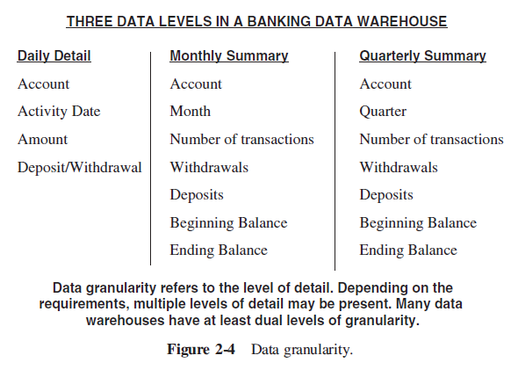
Example: Granularity
Data granularity refers to the level of detail. Depending on the requirements, multiple levels of detail may be present. Many data warehouses have at least dual levels of granularity.

Slide 17
Comparison
Feature | Operational Databases | Data Warehouses
Users | Thousands | Hundreds
Workload | Preset transactions | Specific analysis queries
Access | To hundreds of records, write and read mode | To millions of records, mainly read-only mode
Goal | Depends on applications | Decision-making support
Data integration | Application-based | Subject-based
Quality | In terms of integrity | In terms of consistency
Time coverage | Current data only | Current and historical data
Updates | Continuous | Periodical
Model | Normalized | Denormalized, multidimensional

Slide 18
Business Intelligence (BI)
Business Intelligence is a combination of technologies to improve business decision making by fact-based support systems
The data warehouse (DW) stores the data. Analysis tools use the DW
Reports, which are defined by a query and a layout. (e.g. monthly receipts during the last quarter for every product category)
OLAP tools, which enables users to interactively analyze multidimensional data from multiple perspectives.
What-if analysis (sensitivity analysis)
Data mining, which discovers patterns and relationship in data (e.g. market basket analysis)
A DW is a means rather than a goal…it is only a success if it is heavily used

Slide 19
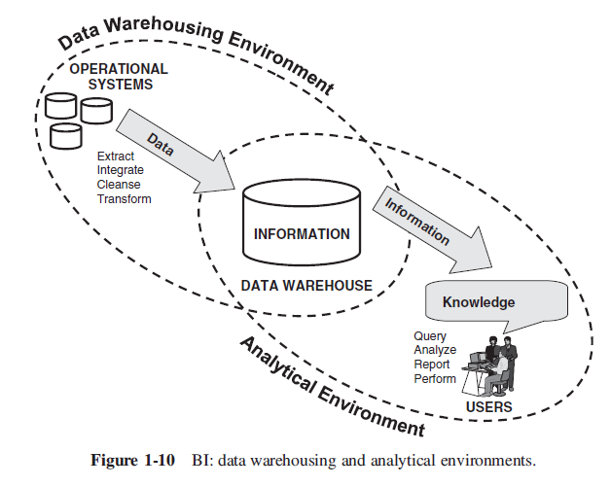
Business Intelligence (BI)

Slide 20
Review Questions
A typical retail store collects huge amount of data through its operational systems. Name three types of transaction data likely to be collected by a retail store in large volumes during its daily operation.
Examine opportunities that can be provided by strategic information
Other industries to consider: bank, medical center
Describe five difference between operational data and strategic information.
What are the defining features of data warehouses? Explain each feature and contrast it with operational databases.
Illustrate the idea of granularity with an example of different data levels in a data warehouse for a retail store.

Slide 21
Part B. Architecture
Layer architecture
Data integration
Inside the data warehouse layer
Data marts vs. Data warehouses
Metadata
Data warehouse design approaches
Hub-and-spoke
Bus

Slide 22
Two-Layer Architecture
In the two-layer architecture, a data warehouse separates sources from analysis applications.
Source layer
Operational data
External data
Data staging
ETL tools
Data warehouse
metadata
Data warehouse layer
Data mart
Analysis
Reporting tools
OLAP tools
Data mining tools
What-if analysis tools

Slide 23
Data Staging
A data warehouse system uses heterogeneous sources of data.
Data from operational systems include relational databases and files (e.g. Excel spreadsheets, XML files)
Data outside the corporate walls include the Web and other external data sources like reports and data sets
Source data have inconsistencies and are in different data model and format!
ETL tools (Extraction, Transformation, and Loading) can merge heterogeneous schemata, extract, transform, cleanse, validate, filter and load source data into a data warehouse
Data warehouse
Notes:
All functions for transforming and integrating the data are completed in the data staging area

Slide 24
Inside the Data Warehouse Layer
Information is stored at one logically centralized single repository called data warehouse.
The data warehouse for an enterprise is usually complex and huge
Too complex to build in one step
Not all information are necessary for a certain analysis task
A data mart is a subset or an aggregation of the data stored to a primary data warehouse. It includes a set of information pieces relevant to a specific business area, corporate department, or category of users.
A metadata repository keeps metadata. These metadata specifies data sources, transformation processes, population policies, logical and physical schemata, and user profiles.
Data warehouse
Data mart
metadata

Slide 25
Approaches to Structure DW
Data warehouse
Data mart
Data mart
Data warehouse
Data mart
Data mart
Data mart
Hub-and-spoke
Extract required data into a data mart for running analysis
Data-Mart Bus
Data warehouse as a collection of data marts

Slide 26
Hub-and-Spoke Architecture
Top-down approach. Recommended by Bill Inmon.
A data warehouse as a centralized repository for the entire enterprise
stores data at the lowest level of detail. Usually relational model.
Data marts are created on demand for departmental analytical needs
May filter and aggregate DW data
Better performance than running query directly on DW
May also run analysis directly on DW
Data staging
Data warehouse
Data mart
Data mart
Data mart
Analysis

Slide 27
Bus Architecture
Bottom-up approach. Recommended by Ralph Kimball.
A data warehouse as a collection of data marts with conformed analysis dimensions.
Data marts are independent, and used as building blocks while incrementally developing DW
Store data at the lowest level of detail and also as summaries. Dimensional model.
Data marts are joined or 'unioned' together by dimensions
Conformed data marts
Data mart
Data mart
Data mart
Analysis
Notes:
In this architecture type, no distinct, single data warehouse exists.

Slide 28
Hybrid Approach
To handle the complexity of ETL process from operational data to data mart, some designer adds a reconciled data layer
Usually uses relational data model
Operational data are integrated and cleansed and the obtained data are saved in reconciled data layer
i.e. reconciled data layer is a consistent model of all corporate data, but its data model may not be suitable for data analysis
Some ETL tool handles differences in data models when it loads data from reconciled data layer to data marts
External data
External data
ETL tools
Reconciled data
Metadata
ETL tools
Data warehouse
Data mart
Data mart
Data mart
Notes:
The reconcile data layer materializes operational data obtained after integrating and cleansing source data. As a result, those data are integrated, consistent, correct, current, and detailed.
The main advantage of the reconciled data layer is that it creates a common reference data model for a whole enterprise. At the same time, it sharply separates the problems of source data extraction and integration from those of DW population.

Slide 29
Benefits of Data Warehouses
The ETL tools integrate and clean the data from operational databases when they load the DW
But they also duplicate the data …
Benefits to separate the DW from operational databases:
High availability of good quality data for analysis
Special-purpose data model for DW
Optimized data stores and indexing for DW

Slide 30
Benefits, 1
High availability of good quality data for analysis
Good quality information is always available, even when access to sources is denied
Analysis query processing typically involve a large amount of disk I/O and CPU time. It is important to ensure that data analysis does not affect the reliable processing of transactions in operational systems.

Slide 31
Benefits, 2
Special-purpose data model for DW
Operational databases are generally based on relational model. This model is suitable for data of fine granularity and linked by complex relationship
DWs are logically structured according to the multidimensional model
easier to understand
keep both detail and summarized data

Slide 32
Benefits, 3
Data warehouses can use specific design solutions aimed at performance optimization of analysis and report applications
E.g. column-oriented data stores, bitmap indexes
Ref: https://docs.oracle.com/database/121/DWHSG/schemas.htm#DWHSG019
 | Operational databases | Data warehouses
Concurrency control and recovery | Required to ensure the consistency and robustness of transactions | Not required. OLAP uses mainly read-only access
Access methods | Typical SQL queries need to join several tables, but involve a smaller number of records | OLAP queries involve computation of large groups of data at summarized levels.
Time coverage | Current data only | Current and historical data. Data loading are done in batches

Slide 33
Difference in Concurrency Control
Typical transactions in operational databases involve both reads and writes
Concurrency control is essential to ensure consistency and robustness of transactions
(consider ACID properties)
In addition, need to recover from transaction failure.
OLAP mainly uses read-only access. NO concurrency control is required.
Data loading is done in batches
Notes:
Atomicity guarantees that each transaction is treated as a single "unit", which either succeeds completely, or fails completely.
Consistency ensures that a transaction can only bring the database from one valid state to another, maintaining database invariants
Isolation ensures that concurrent execution of transactions leaves the database in the same state that would have been obtained if the transactions were executed sequentially.
Durability guarantees that once a transaction has been committed, it will remain committed even in the case of a system failure.

Slide 34
Difference in Access Methods
Typical transactions in operational databases need to join several tables, but involve a smaller number of records
In typical SQL queries, we need to
Join several tables using primary and foreign keys
Select a limited number of records from a large table using filter conditions
OLAP queries involve computation of large groups of data at summarized levels.
We need to
Select a large portion of records from a large table
Summarize some columns, e.g. find the total sales amount

Slide 35
Difference in Time Coverage
Operational databases usually only keep current data, which may change frequently
E.g. purchase orders in an online shopping mall
Data warehouses keep both current and historical data
E.g. purchase records of last 5 years
The data seldom changes after loading
Data loading are done in batches

Slide 36
Review Questions
Describe the Two-layer architecture of data warehouse.
What are the benefits of this architecture?
Describe the difference in data model between the data warehouse and operational databases.
Explain the different requirements in concurrency control and access method in OLAP and OLTP.
Trace the flow of data through the data warehouse from beginning (source data) to end (analysis result).
What are the functions of data staging?
Compare data warehouses with data marts.
Describe the bus architecture and the hub-and-spoke architecture.

Slide 37
Part C. Design Methodology
We will use the Bus architecture and design data marts with conformed analysis dimensions in this course.
Goals of data mart design
The reconciled data layer
How to design
How to populate
Seven phases in the Design Methodology

Slide 38
Data Mart Design
Given user requirements of strategic information and existing operational data, the goals of data mart design are
To design a logical / physical schema that is suitable to answer users' analysis requirements
To design an ETL procedure which loads the data mart from operational data
Operational data
ETL procedure
Data mart
Data mart
Logical schema of data marts
Requests for strategic info in Analysis services

Slide 39
Defining and Populating the Reconciled Layer
Operational data
Source data schemata
data
Data samples
Analysis and Reconciliation
ETL procedures
Reconciled schema, mapping with data sources
Staging Design
metadata
Logical schema of data marts
Other phases in Data mart design
Reconciled data

Slide 40
Analysis and Reconciliation
This phase defines and documents the reconciled schema
(Analysis) Understand the meaning and structure of source data
Analyze and understand available source schemata
Select which groups of data can be useful for the purposes of decision-making for the data mart
Assess data quality
(Reconciliation) remove inconsistencies and integrate the data
Cleansing
Transformation
If multiple data sources are to be used, integrate their schemata to determine common features and remove every inconsistency

Slide 41
Cleansing
Improves data quality by rectifying data values
Duplicate data (e.g. a patient is recorded many times)
Inconsistent values that are logically associated (e.g. addresses and ZIP codes)
Missing data
Unexpected use of fields (e.g. email field to store tel no.)
Impossible or wrong values (e.g. 2/30/2009)
Inconsistent values for a single entity (e.g. Macau vs. Macao, abbreviation)
Typing mistakes

Slide 42
Transformation
Convert data from its source format into the DW format
Unit of measures (e.g. length in meter vs. feet)
Different data format (e.g. 1/2/2012, Feb 1, 2012)
Separation (e.g. split a name into first name and last name, split an address into building, street, zip code, city and country)
Matching equivalent fields in different sources
Different data model (e.g. XML to relational)

Slide 43
Exercise
// DB1. Mobile service
Customer (contractNo, firstName, lastName, idcard, mobileNum, address, contactTel, emailAddr)
VoiceUsage (callerMobileNum, calleeMobileNum, startTime, duration)
DataUsage (mobileNum, hourInDay, kbyteSent, kbyteReceived)
// DB2. Broadband service
Customer (userid, fullname, idcard, telephone, address)
Usage (userid, hourInDay, mbSent, mbReceived)
A telecommunication company provides both mobile phone and broadband Internet services. There are separate operational databases for the two services. The management wants to analyze the data usage of customers in different hours in a day. You are requested to design a data mart to integrate the data usage data from both databases. Discuss various issues involved in the design of the reconciled data layer.

Slide 44
Partial Solution
Integration:
How to identify the same person who is a patron of both services?
How to map the attribute of the two tables?
Primary key of the customer table in the reconciled schema?
How to merge the data usage in mobile and broadband networks?
Cleansing and transforming:
Different unit?
Missing data? Separation
Also try to write the schema for the reconciled data layer.

Slide 45
Staging Design
Define ETL procedures in order to load the data coming from operational sources into data marts
Operational data ⇨ reconciled database:
Most complex
Handle cleansing, transformation and integration
Reconciled database ⇨ data marts:
Adjust the data in reconciled data to the star schema used for multidimensional analyses
Calculation of derived data
Denormalization, surrogate key, aggregate data
Usually implemented in data integration tools, e.g. 'Microsoft SQL Server Integration Services'
Operational data
ETL tools
Reconciled data
Metadata
ETL tools
Data mart
Data mart

Slide 46
Design Methodology of Data Mart
We will use a seven phase methodology to design a data mart
Analysis and reconciliation – design and document the reconciled schema
Requirement analysis – designers collect, filter, and document end-user requirements to select relevant information to achieve strategic goals
Conceptual design – create conceptual schema based on user requirements and reconciled schema
Workload refinement – validate the conceptual schema by checking the query workload against the schema
Logical design – select a logical model (e.g. ROLAP) and design logical schema
Data staging design – design the population process (ETL)
Physical design – select indexes to optimize performance. Also select the specific DBMS

Slide 47
Design Methodology
Analysis and Reconciliation
Requirement analysis
Reconciled schema, mapping with data sources
User requirements
Conceptual Design
Workload refinement
Reconciled schema
Conceptual schema
metadata
Fact schema
Reconciled schema
Logical schema
Logical Design
Workload, data volume
Staging Design
Logical schema
ETL procedures
Physical Design
Physical schema

Slide 48
Phases | Input | Output | People involved
Analysis and reconciliation | Operational source schemata | Reconciled schema | Designer, data processing center staff
Requirement analysis | Strategic goals | Requirement spec, preliminary workload | Designer, end users
Conceptual design | Reconciled schema, requirement spec | Fact schemata | Designer, end users
Workload refinement | Fact schemata, preliminary workload | Workload, data volume, validated fact schemata | Designer, end users
Logical design | Fact schemata, target logical model, workload | Logical data mart schema | Designer
Staging design | Source schemata, reconciled schema, logical data mart schema | ETL procedures | Designer, database administrators
Physical design | Logical data mart schema, target DBMS, workload | Physical data mart schema | Designer
Chap 2
Chap 2
Chap 2
Chap 3

Slide 49
Review questions
What are the goals of data mart design?
What are usually done in the 'Analysis and reconciliation' phase?
List four examples of data cleansing and data transforming in data staging.
Try to design the schema of the reconciled database in the telecommunication company example.
Describe the seven phases in the design methodology for data mart. Draw a diagram to illustrate the input and output of each phase.
Compare the design methodology of data marts with the design methodology of operational databases.

Slide 50
Outline for the rest of the course
Data Warehousing
Chap 2. Requirement analysis, Conceptual design
Chap 3. Logical design
Data Analysis
Chap 3. 2nd half. Relational OLAP
Chap 4. Multidimensional OLAP
Chap 5. Data mining

